Slide 1




Fluctuation in Oil Prices
Threats and Opportunities – An Academic Vision
February 2016

Slide 2

Table of Contents
Fluctuation in Oil Prices
Crisis Effects
Winners or Losers?
Energy Consumption Patterns
Learned Lessons & Bright Spots
An Academic Vision: Expected Actions
Conclusion

Slide 3
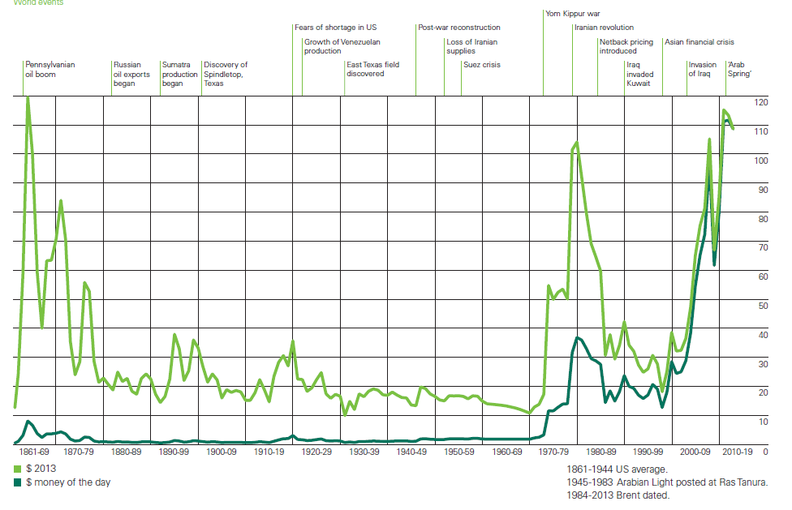
Fluctuation in Oil Prices
Prices
BP Statistical Review, 2014

Slide 4
Crisis Effects
Effects
Strategic
Collapse of oil exporters/ importers
Developmental
Industry Consolidation
Renewables production
LNG Mega-Projects
Oil Prices limits
Shale extraction and offshore drilling
Social
Benefits to consumers
Squeeze in oil jobs
Economical
Bank deposits and international trade
Increase in unemployment
Limits of debt expansion
Inflation/ Deflation and difficulty in repaying debts

Slide 5

Winners or Losers?
A Test
Russia
  Interest rate
  O&G exports
  Losses
  Reactions and reasons behind
Venezuela
  Inflation reached 60%
  Major oil exporter
  Reactions
Saudi Arabia
  Largest producer and exporter
  Politics or US shale gas
  Lower prices and long term market share
USA
  Stopping shale gas production
  Importing
Who is the winner?

Slide 6
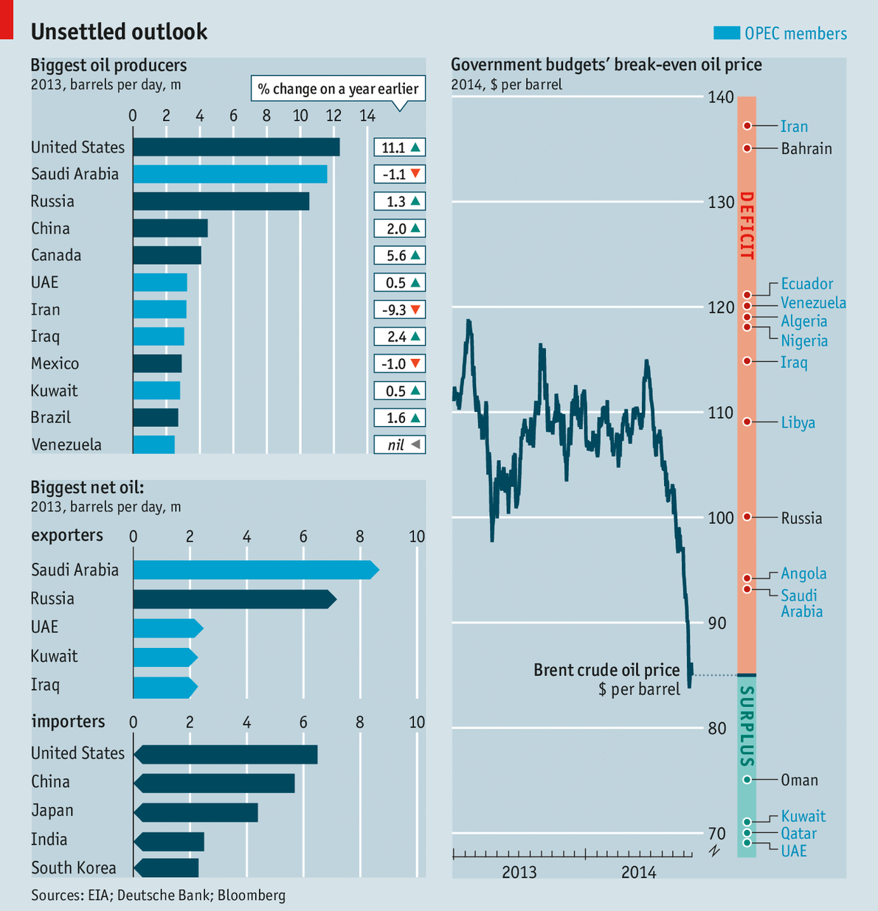
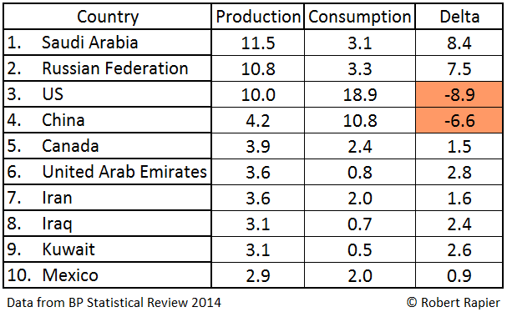
Crude Oil: Importers and Exporters
A Test
Top 10 Oil Producers
EXPORTERS
IMPORTERS

Slide 7

Energy Security & Strategic Planning
A Test
Importing countries are not the winners
Exporting countries are not the losers
Results are not going to be determined now
A Test of
Endurance and
Strategic Planning

Slide 8
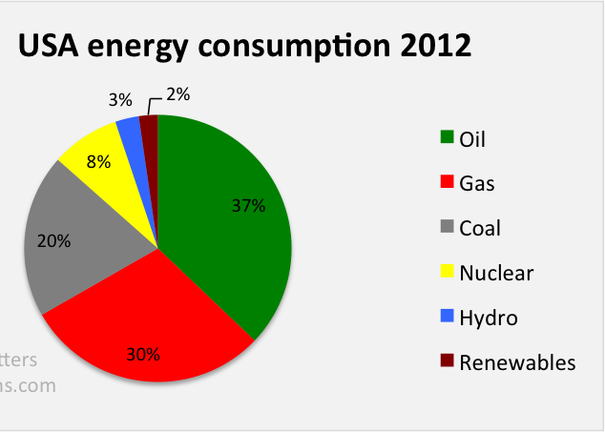
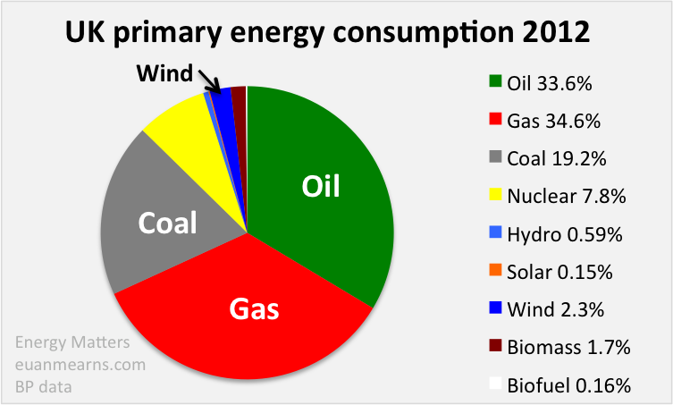
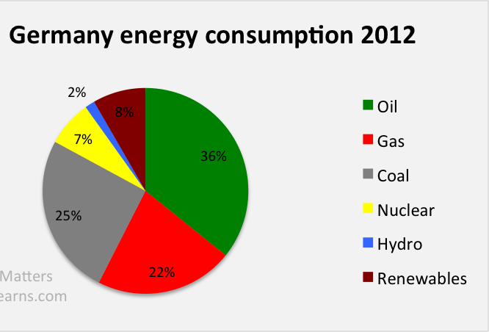
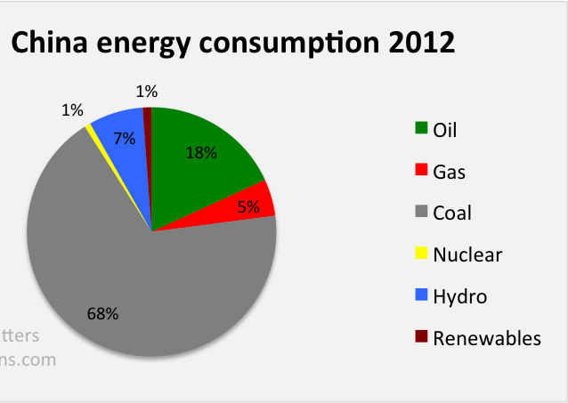
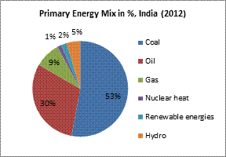
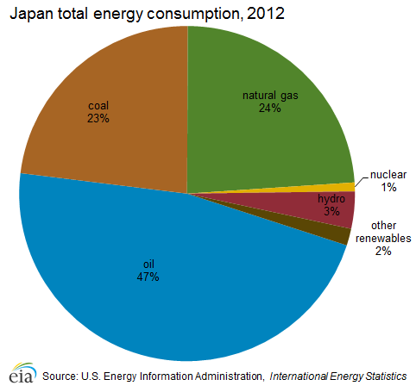
Energy Consumption Pattern
Countries
India energy consumption 2012
Japan energy consumption 2012
Oil
Coal
NG
Nuclear
Hydro
Renewables

Slide 9
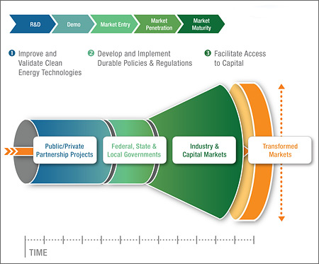
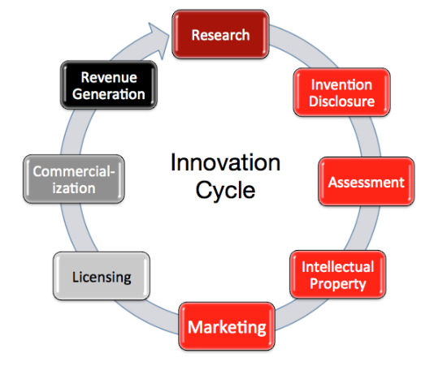
Learned Lesson: Technology Localization
Lesson

Slide 10
An Academic Vision Expected Actions

Slide 11
MSRC
MSRC Research Plan 2012 - 2020
MSRC Research Plan
Hydrocarbon Energy
Mini plant for LNG Recovery
LNG
Hub
in Egypt
Renewable Energy
Solar Energy
Power-to-Gas
Improved Refining Efficiency
Drag Reducing Agents
Energy Conservation
Terms
&
Conditions of
Contracts
Unconventional EOR (Seismic Waves)
Oil
Shale
Gas Shale &
Tight Gas
Reservoir
-Geo
Thermal
Energy
Bio-
fuels
EOR

Slide 12
معمل الــ EOR
أهمية المعمل
  المعمل ضرورى لاستكمال دراسات ال EOR
  عمل تقييم دقيق لقيمة الاحتياطى البترولى المتواجد فى الحقول المصرية الناضبة
  رفع المستوى المهارى وبناء القدرات الذاتية للسادة المهندسين العاملين بقطاع البترول المصرى
التكلفة المقدرة للمعمل 3 ملايين دولار أمريكي.
موافقة معالي وزير البترول على تمويل المعمل.
انشاء المعمل فى مقر شركة OGS
تبرع شركة سوميد بمبلغ 100 ألف دولار.
ESTIMATED BUDGET
$ 3 MILLION
RELATIVE
PERMEAMETER
HC ANALYZER
STEAMFLOOD
CHEMFLOOD
GASFLOOD

Slide 13
Conclusions
Strategy
Research: A strategic obligation
MSRC research plan: A role model
EGPC support and collaboration: The key to success
Apply the findings to reality: Develop a prototype

Slide 14
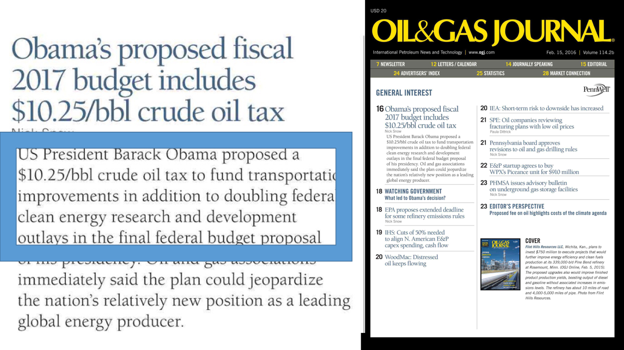

Slide 15

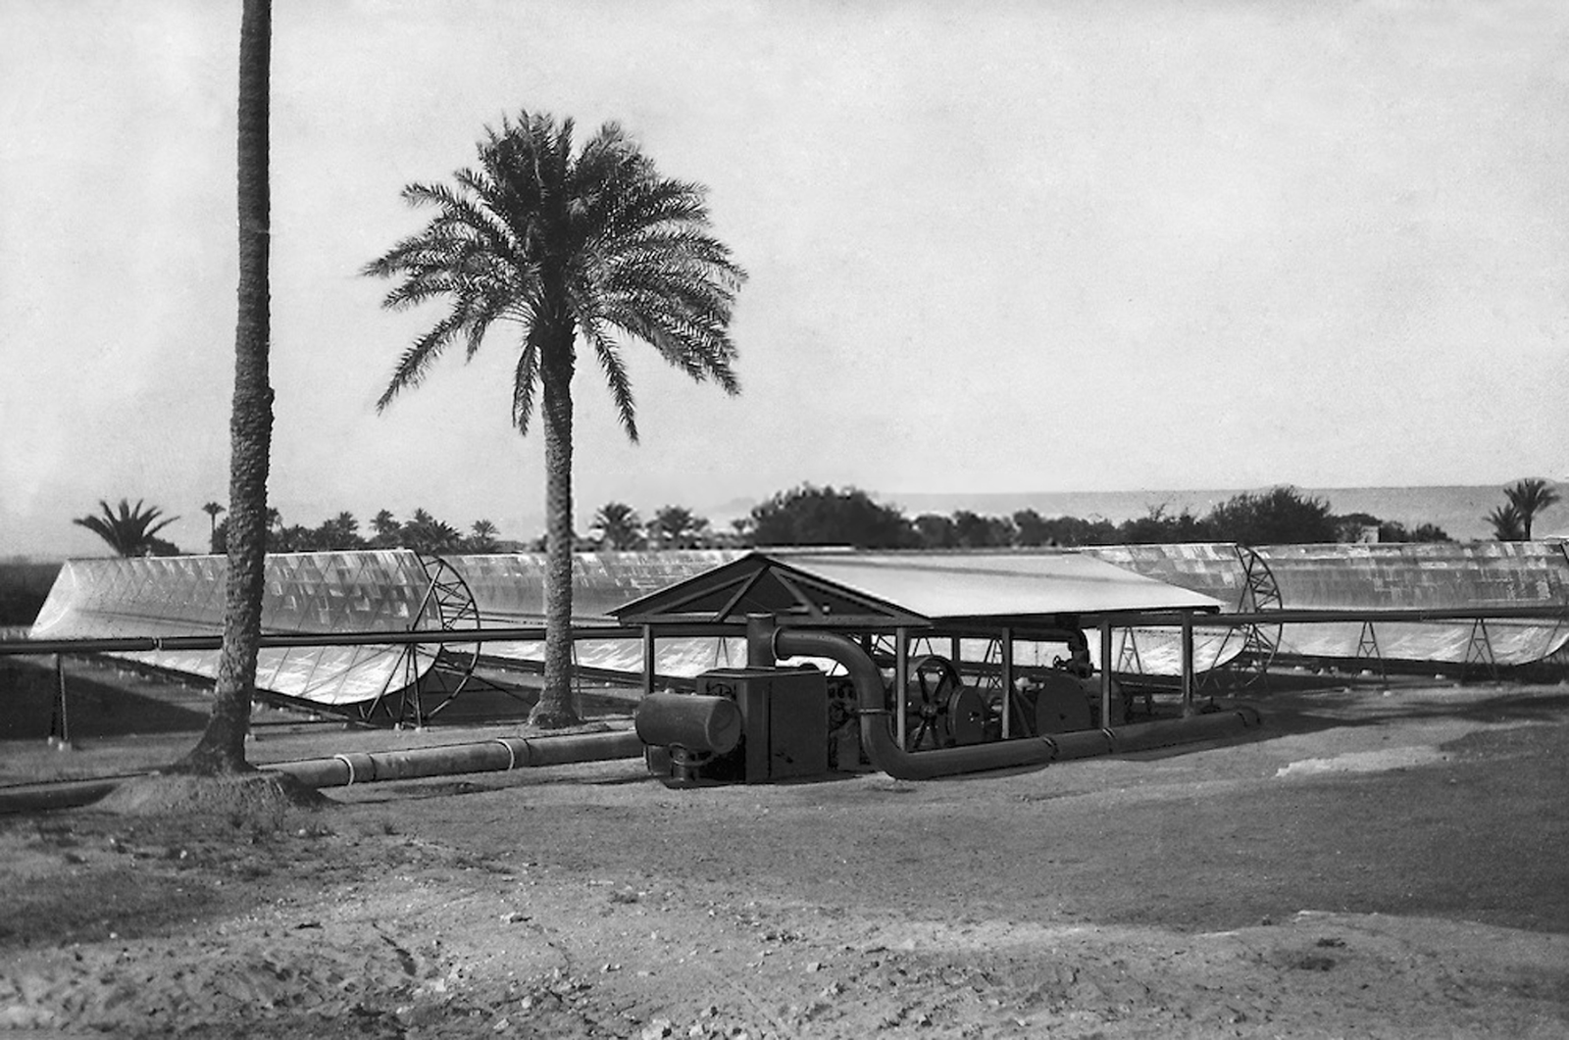
مصر تنشىء أول محطة طاقة شمسية فى العالم 1913
Egypt

Slide 16


